Slide 1
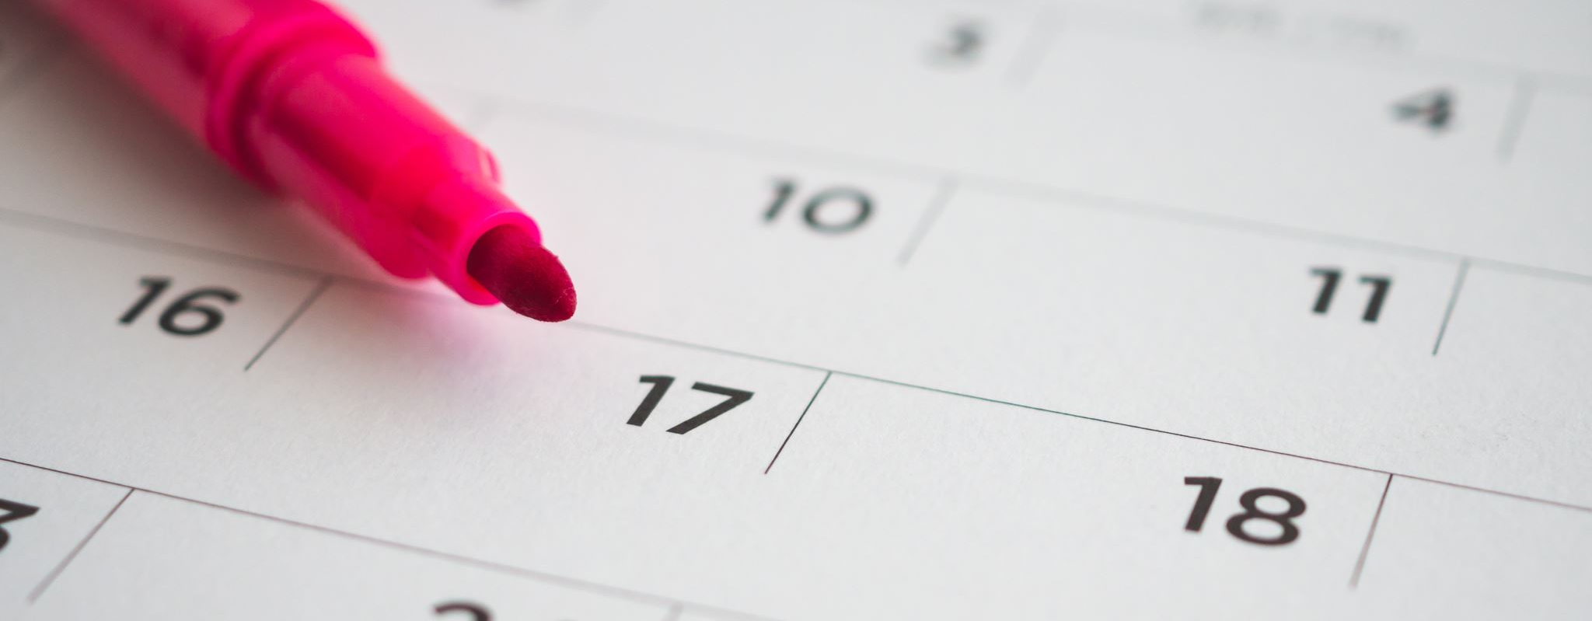
Lesson 7
Dani u nedelji/sedmici
Days in the week

Slide 2
Objectives
Review days in the week
Review nominativ, akuzativ, instrumental

Slide 3
Activity 1
Read sentences from page 36

Slide 4
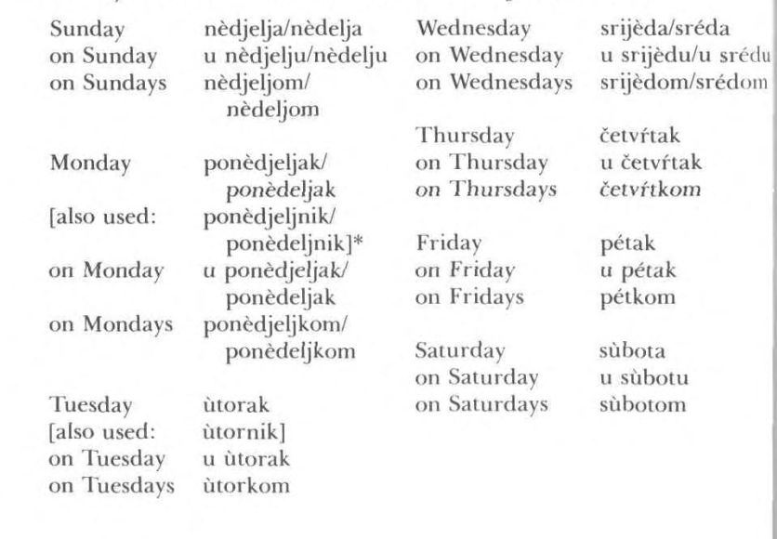
Page 40
Nominativ- Which day it is?
Akuzativ- On which day will/did something occur?
Instrumental- On which day something usually occurs

Slide 5
Akuzativ- Jednina (singular)
- Feminine nouns that end in a – drop a and add u
- Masculine nouns that end in a – drop a and add u
- Masculine Inanimate Nouns that end in consonant – Same as Nominative
- Neuter Nouns- Same as Nominative
- Feminine nouns that end in consonant- Same as Nominative
- Masculine Animate Nouns that end in consonant- a is added

Slide 6
Akuzativ množine (plural)
- Feminine nouns, F2, Neuter nouns have accusative plurals that are identical to their Nominative plurals.
Masculine nouns (both animate (living things) and inanimate) change their ending in acc.plural to E
Adjectives- masculine and feminine plurals: djectival ending is –E
Adjectives- neuter- ending is –a (same as nouns)

Slide 7
Instrumental
Feminin nouns singular end in –om
Masculine and neuter nouns singualr end in –om/em
em is used after soft consonants like š, ž, ć, đ, j, lj, nj (sometimes r,c,t).
-F2 nouns end in –i, and -ju
Adjectives singular F2 and feminin- end in –om
Adjectives Masculine and neuter singular- end in –im
- All nouns have instrumental plural identical to their D/L plural forms:
masc., neuter and F2 take -ima:
regular feminine take –ama
All adjectives regardless of gender have instrumental plural forms identical to D/L plural forms: -im:

Slide 8
Practice
Activity 2: Answer the questions from Vežba/vježba 1
Activity 3: Do vežba/vježba 2
Activity 3: Do vežba/vježba 3
Activity 4: Turn sentences from vežba 3 to past tense

Slide 9
Homework
Practice for Vocab Quiz

